Slide 1

From Sit and Get to Go and Show Reimagining Professional Learning in the Hematology/Oncology Fellowship Program By: Kary S. Magliolo-Garnica

Slide 2

Why change now?
Our Division is a POWERHOUSE of expertise
Faculty have knowledge to share
Notes:
Instead of one-off workshops, imagine ongoing learning communities where faculty engage, reflect, and apply new practices — supported across divisions. A model where innovation in one department becomes the norm for all.

Slide 3
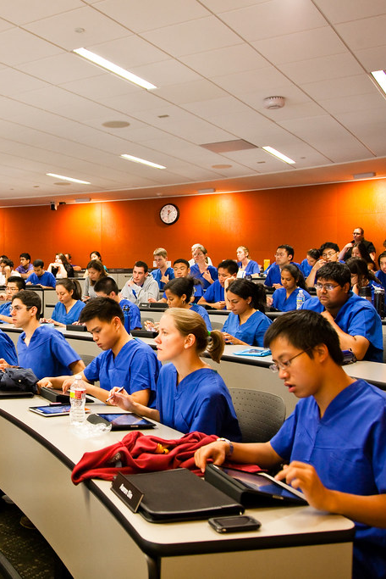
Why Change is URGENT
Traditional approaches to professional development fail to meet the learning needs of today’s clinicians or support the practical application of new skills
Time is limited
Learning is contextual
Impact must be immediate

Slide 4
What Could Be
If we embrace an alternative model of professional development, we can align with physicians and how they learn.
Reflection
Collaboration
Application
Elendu, Amaechi, Okatta, Amaechi, Elendu, Ezeh, & Elendu, 2024
Notes:
.

Slide 5
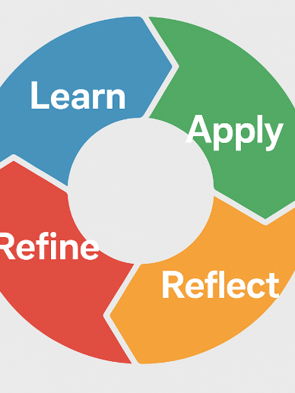
Extended Duration
Learning will stick when it’s ongoing
Educational mastery, just like clinical mastery, requires repletion and reflection (Eppich, Hunt, Duval-Arnould, Siddall, & Cheng, 2015).
Monthly Sessions for faculty to revisit and refine strategies to keep us moving in the right direction

Slide 6

Ongoing Support from Leadership
Structured Follow up to include:
Mentoring
Peer observation
Coaching
Micro Show and Share sessions
Reflection/Discussion/Follow-up

Slide 7

The 5 Principles of Effective Professional Development
Extended Duration →Monthly Sessions
Ongoing Support → Mentorship follow-up
Active Engagement → Demonstrations
Leader Modeling → Rotating faculty
Subject Specific → Focus by subspecialty

Slide 8
Leader Modeling
When leaders model effective learning, it gives permission for others to do the same.
If an attending demonstrates curiosity, reflection and seeks feedback, fellows will too.
We must model vulnerability and growth

Slide 9

Subject Specific Learning
Generic training rarely resonates in medicine.
Learning must be grounded in clinical reality of oncology cases, multidisciplinary teamwork and patient safety scenarios
We need professional learning that is relevant to our learners’ environment.
Notes:
.

Slide 10
What If there is NO change?
Lost engagement
Missed opportunities for innovations
Burnout from irrelevant training
Disconnect between education and practice
Our patients will suffer
Notes:
.

Slide 11
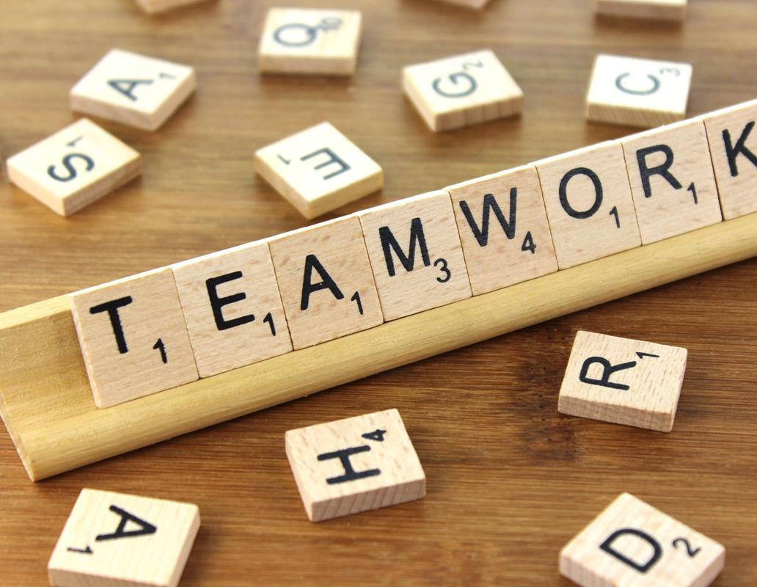
Our Call to Action
Let’s redefine professional learning as a shared, clinical practice. Not an event.
We will start small in the first Quarter: Pilot with 4 departments
Gather Feedback/Refine as Needed
Grow to all 16 departments
We can’t teach the future of medicine with the methods of the past

Slide 12

References:
Winkel, A. F., Yingling, S., Jones, A. A., & Nicholson, J. (2017). Reflection as a Learning Tool in Graduate Medical Education: A Systematic Review. Journal of graduate medical education, 9(4), 430–439. https://doi.org/10.4300/JGME-D-16-00500.1
Eppich, W. J., Hunt, E. A., Duval-Arnould, J. M., Siddall, V. J., & Cheng, A. (2015). Structuring feedback and debriefing to achieve mastery learning goals. Academic medicine : journal of the Association of American Medical Colleges, 90(11), 1501–1508. https://doi.org/10.1097/ACM.0000000000000934
Elendu, C., Amaechi, D. C., Okatta, A. U., Amaechi, E. C., Elendu, T. C., Ezeh, C. P., & Elendu, I. D. (2024). The impact of simulation-based training in medical education: A review. Medicine, 103(27), e38813. https://doi.org/10.1097/MD.0000000000038813

